Slide 1
Linux Architecture
Files, Attributes, Filesystems

Slide 2
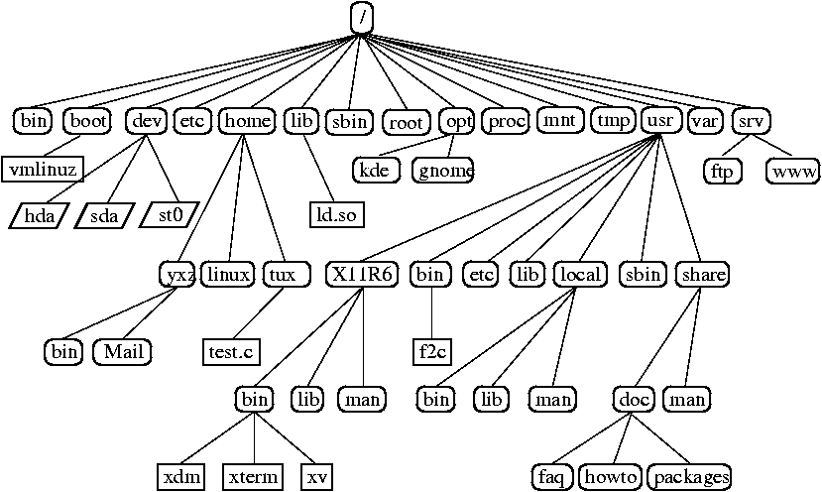
HIER
/etc – system configuration files
/bin – “binary”, executable files
/sbin – same as /bin, but for super user
/tmp – temporary files
/root – homedir for root user
/home – homedir for other users (/home/ubuntu)
/dev* – device files
/lib – libraries, binary files without main()
/boot – kernel, initrd (drivers), configuration.
/var – DATA
/proc* – information about running process
/mnt – mount point for external block devices
/usr/{bin,sbin,lib} – additional files, which shouldn’t be in root
/usr/local/{bin,sbin,lib,etc} - additional files, which shouldn’t be in root

Slide 3
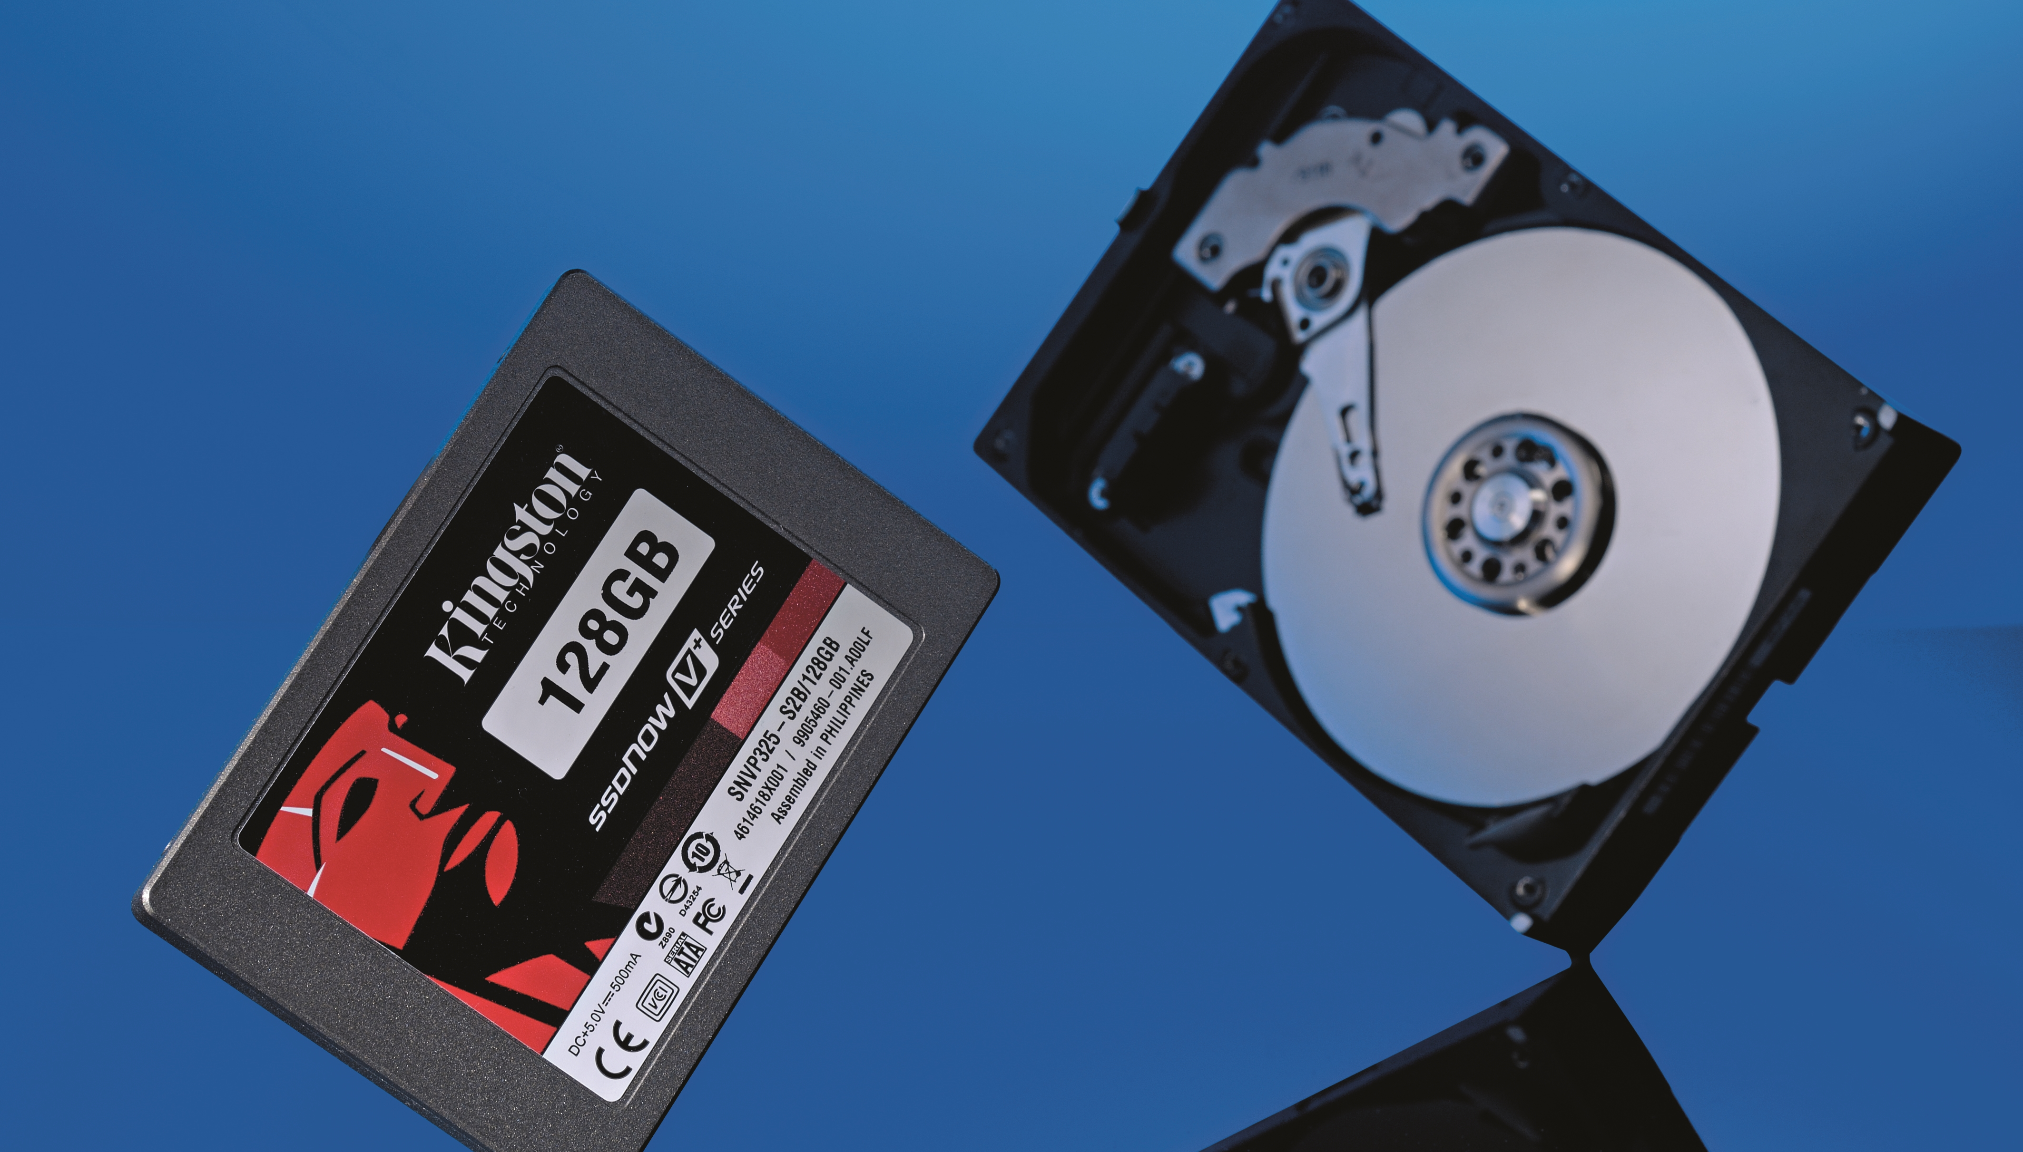
Block device
Блочное устройство (block device) — вид файла устройств в UNIX/Linux-системах, обеспечивающий интерфейс к устройству, реальному или виртуальному, в виде файла в файловой системе.
С блочным устройством обеспечивается обмен данными блоками данных. Как правило, это устройства произвольного доступа, то есть можно указать, из какого именно места должен быть прочитан или записан блок данных.
IO IOps

Slide 4
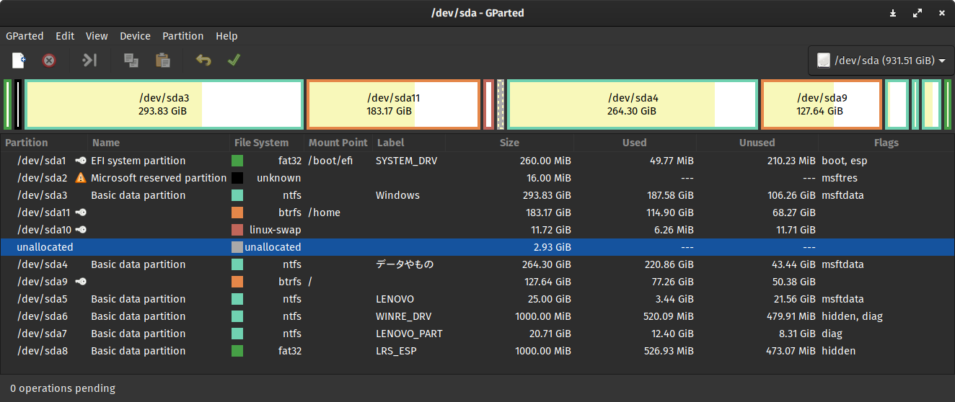
Volumes - тома, Partitioning – партиции, разделы.
Disk partitioning or disk slicing^{[1]} is the creation of one or more regions on secondary storage, so that each region can be managed separately.^{[2]}These regions are called partitions. It is typically the first step of preparing a newly installed disk, before any file system is created.
s-sata hdd, ssd : h-hdd : f-fdd d – disk
a b c d

Slide 5
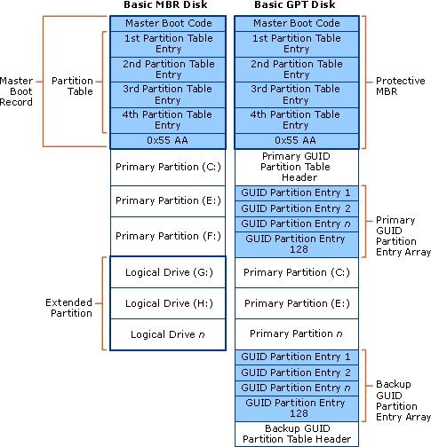
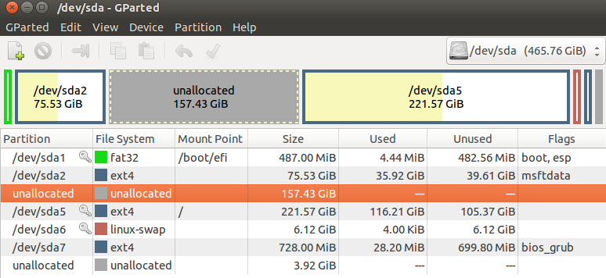
Disks Partitioning
/dev/hda /dev/hdb /dev/sda /dev/sda1 /dev/sda2 /dev/sda3 /dev/sda{5,6,7,8…}
GPT, MBR, BSD/Sun, IRIX/SGI partition tables
Disk slices, disk label
fdisk, cfdisk, sfdisk, parted, partx, gparted, windows NT disk manager

Slide 6
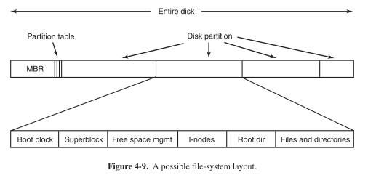
Filesystem from Disk point of view

Slide 7
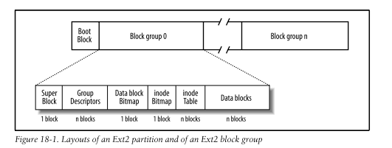
Filesystem

Slide 8
File Systems
Disk File Systems:
FAT 8/16/32
NTFS
ext2/3/4
xfs
jfs
reiserfs
zfs
btrfs
Shared Disk File Systems:
GPFS (IBM)
Xsan (Apple)
VMFS (VMware)
GFS2 (Red Hat)
Distributed File Systems:
9P (Plan 9)
Lustre
NFS
SMB/CIFS
Distributed Parallel Fault-Tolerant File Systems:
CephFS
glusterFS
MooseFS
GFS (google)
HDFS (Hadoop)
Lustre
GPFS
Exotic File Systems:
pingfs
pifs
IPFS
Gmail fs
Pseudo File Systems:
procfs
sysfs
devfs
CONFIDENTIAL | © 2019 EPAM Systems, Inc.

Slide 9
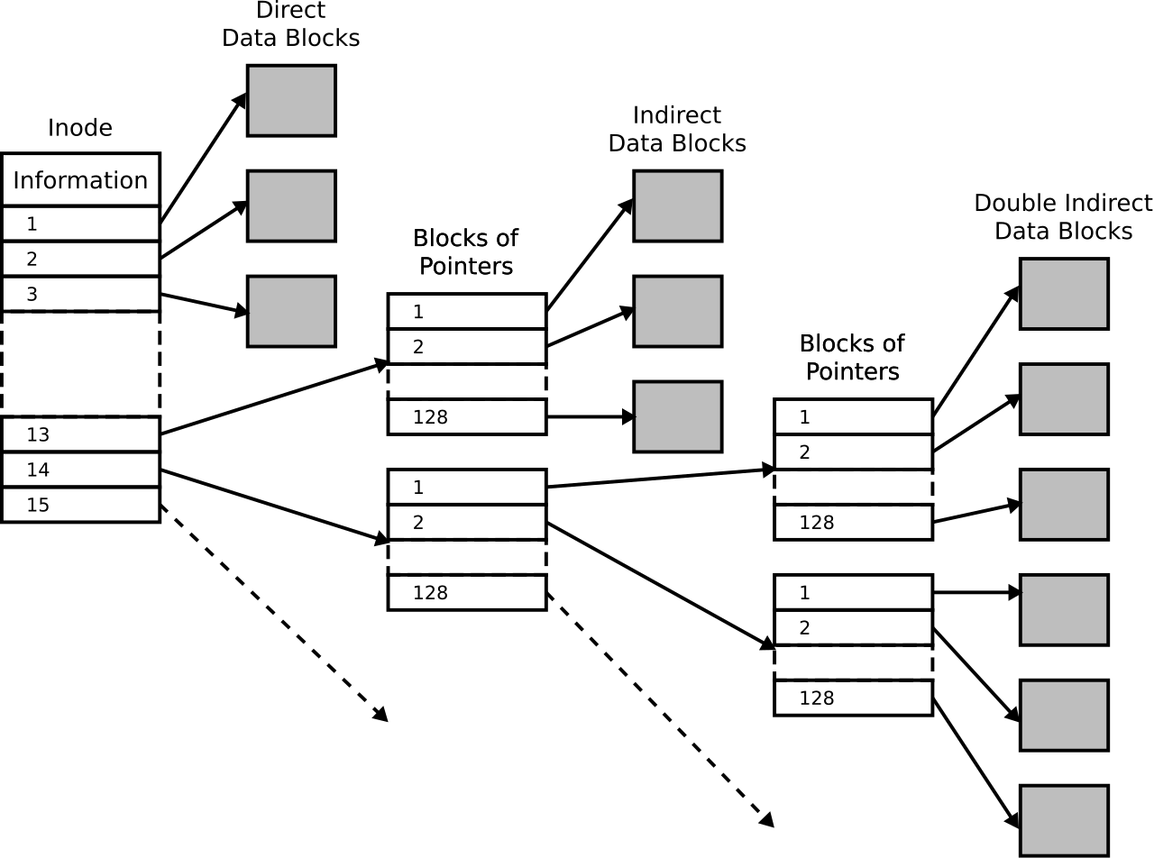
i-node
atime
mtime
ctime
size
Number of links
uid
gid
mode
i-node number

Slide 10
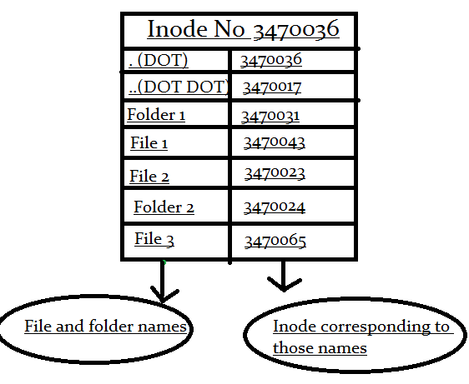
Directory i-node data:
Key value pairs
Key – filename
Value – i-node number

Slide 11
i-node management commands
ln
touch
cp
rm
unlink
df
du
ls -s
pwd
cd
chroot
chown
chmod
stat

Slide 12
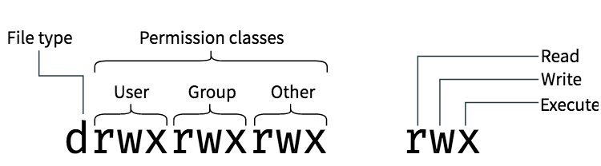
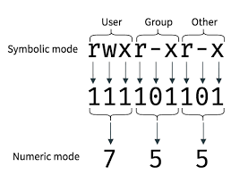
permissions
7 == rwx
6 == rw-
5 == r-x
4 == r--
3 == -wx
2 == -w-
1 == --x
0 == ---
Files: 664, 644, 660, 640, 600
Executable files: 777, 775, 755, 770, 750
Directories: 777, 775, 755, 770, 750

Slide 13
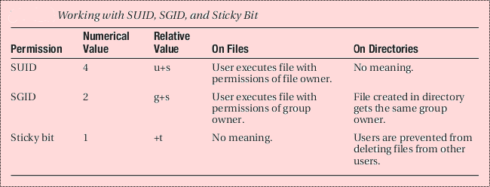
extra permissions
7777 = rwsrwsrwt
6777 = rwsrwstwx
5777 = rwsrwxrwt
4777 = rwsrwxrwx
3777 = rwxrwsrwt
2777 = rwxrwsrwx
1777 = rwxrwxrwt
0777 = rwxrwxrwx

